Slide 1
. HOSPITAL MANAGEMENT SYSTEM DATABASE
Mezli Cabrera

Slide 2
Project Idea #3
A patient will have unique Patient ID. Full description about the patient include personal details and phone number, and then Disease and what treatment they are undergoing. Doctors will handle patients; one doctor can treat more than 1 patient. Also, each doctor will have unique ID. Doctor and Patients will be related. Patients can be admitted to hospital. So different room numbers will be there, also rooms for Operation Theaters and ICU. There are some nurses, and ward boys for the maintenance of hospital and for patient take care. Based upon the number of days and treatment bill will be generated.

Slide 3
What entities did you discover in your project?
PATIENT
DOCTOR
HOSPITAL
NURSE
WARD BOY

Slide 4
What attributes do they have?
PATIENT
patientID (PK, int)
firstName (varchar, 100)
lastName (varchar, 100)
age (int)
gender (varchar, 50)
phoneNumber (int, 10)
disease (varchar, 100)
treatment (varchar, 300)
treatmentDaysAmount (int)
billInformation (varchar, 300)
hospitalID (FK)
nurseID (FK)
DOCTOR
doctorID (PK)
patientID (FK)
firstName (varchar, 100)
lastName (varchar, 100)
HOSPITAL
hospitalID (PK)
hospitalName (varchar, 100)
hospitalAddress (varchar, 100)
roomNumber (int)
roomType (varchar, 20)
patientAdmisionInf (varchar, 50)
NURSE
nurseID (PK)
hospitalID (FK)
firstName (varchar, 100)
lastName (varchar, 100)
WARD BOY
wardBoyID (PK)
hospitalID (FK)
firstName (varchar, 100)
lastName (varchar, 100)

Slide 5
What information is probably not important and can be removed?
Disease ? (from Patient)

Slide 6
What information is important and must be included?
I included:
Name and last name for every entity related with people.
Amount of days of treatment.
Bill Information

Slide 7
Can some of these entities be generalized? For example: In a school, Teacher and Advisor are both ‘Staff’
Staff
Nurse
Ward Boy

Slide 8
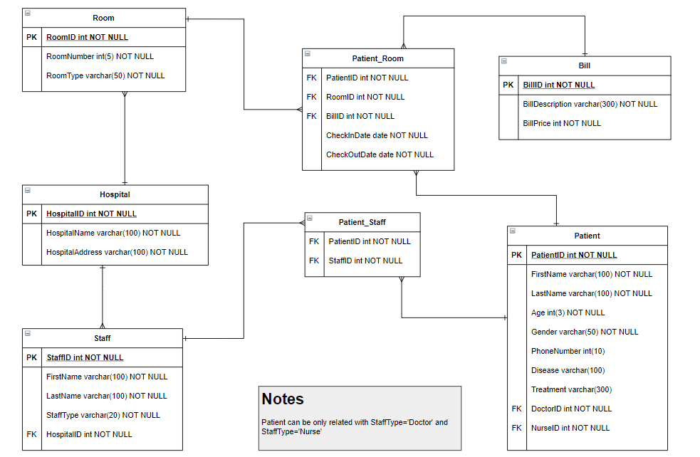
erd

Slide 9
TABLE: PATIENT
PatientID | FirstName | LastName | Age | Gender | PhoneNumber | Disease | Treatment | DoctorID | NurseID
1 | Maria | Rodriguez | 35 | F | +1 216-883-1798 | chronic obstructive pulmonary disease | Atorvastatin (Lipitor) | 10 | 4
2 | Lucas | Mockingbird | 29 | F | +1 505-948-7909 | trachea, bronchus, and lung cancers | Gabapentin (Neurontin) | 3 | 8
3 | Samantha | Lucero | 78 | M | +1 505-644-1338 | Diabetes mellitus | Levothyroxine (Synthroid) | 3 | 7
4 | Jean | Patoyt | 19 | M | +1 301-365-7912 | Alzheimer's disease | Lisinopril (Prinivil, Zestril) | 2 | 4
5 | Arturo | Kafka | 57 | M | +1 531-455-1323 | Dehydration due to diarrheal diseases | Amlodipine (Norvasc) | 1 | 9
6 | Clarice | Gustav | 62 | F | +1 312-904-8215 | Cirrhosis | Hydrocodone/acetaminophen (Vicodin, Norco) | 10 | 8
7 | Hamilton | Mapplethorpe | 25 | M | +1 582-666-6248 | Tuberculosis | Amoxicillin (Amoxil) | 10 | 7
8 | Monica | Suarez | 85 | F | +1 314-358-6003 | Influenza | Omeprazole (Prilosec) | 2 | 7
9 | Hilde | Changestorm | 51 | F | +1 505-358-6633 | Heart disease | Levothyroxine | 3 | 4
10 | Carl | Smith | 99 | M | +1 312-363-0003 | Malaria | Atorvastatin | 1 | 9

Slide 10
TABLE: HOSPITAL
HospitalID | HospitalName | HospitalAddress
1 | Mayo Clinic – Rochester | Rochester, USA
2 | Cleveland Clinic | Cleveland, USA
3 | The Johns Hopkins Hospital | Baltimore, USA

Slide 11
TABLE: ROOM
RoomID | RoomNumber | RoomType
1 | 405 | OR
2 | 201 | ICU
3 | 341 | REGULAR
4 | 205 | REGULAR
5 | 504 | ICU
6 | 125 | REGULAR
7 | 412 | REGULAR
8 | 200 | OR
9 | 401 | REGULAR
10 | 104 | REGULAR

Slide 12
TABLE: PATIENT_ROOM
PatienID | RoomID | BillID | CheckInDate | CheckOutDate
2 | 3 | 6 | 2/2/1904 | 10/3/1903
3 | 2 | 3 | 10/12/1902 | 21/6/1904
3 | 1 | 8 | 10/7/1901 | 11/10/1900
1 | 1 | 1 | 24/1/1905 | 18/4/1903
4 | 1 | 5 | 9/6/1900 | 5/3/1901
10 | 4 | 7 | 2/6/1903 | 28/12/1904
8 | 5 | 2 | 2/6/1905 | 5/2/1903
2 | 7 | 4 | 5/6/1902 | 25/4/1905
6 | 4 | 10 | 29/7/1904 | 29/5/1902
8 | 10 | 9 | 26/10/1902 | 1/9/1904

Slide 13
TABLE: STAFF
StaffID | FirstName | LastName | StaffType | HospitalID
1 | America | Carroll | DOCTOR | 2
2 | Juliana | Lombardo | DOCTOR | 3
3 | Iris | Shermann | DOCTOR | 3
4 | Kaiden | Martinez | NURSE | 1
5 | Luz | Gallegos | WARDBOY | 1
6 | Dawson | Smith | NURSE | 1
7 | Allison | Wilkinson | NURSE | 2
8 | Cooper | Cohen | WARDBOY | 3
9 | Lucia | Valdez | NURSE | 2
10 | Roberta | White | DOCTOR | 3

Slide 14
TABLE: PATIENT_STAFF
PatientID | StaffID
3 | 6
4 | 3
1 | 4
2 | 2
2 | 7
10 | 9
6 | 7
4 | 1
3 | 2
8 | 10

Slide 15
TABLE: BILL
BillID | BillDescription | BillPrice
1 | See attachment for more information | $1.200,00
2 | See attachment for more information | $280,00
3 | See attachment for more information | $100,00
4 | See attachment for more information | $6.000,00
5 | See attachment for more information | $750,00
6 | See attachment for more information | $2.700,00
7 | See attachment for more information | $150,00
8 | See attachment for more information | $3.790,00
9 | See attachment for more information | $2.700,00
10 | See attachment for more information | $3.600,00

Slide 16
reports
Bill information generated according to treatment and number of days.
List of patients being treated by a specific doctor or nurse.
List of patients on surgery.
Number of patients hospitalized in a specific hospital.
List of staff working in a hospital.

Slide 17
Formatting and validations
Patients can be only related with StaffType = 'Doctor' and/or StaffType = 'Nurse'.
* * *
BillPrice from table Bill: money format.
CheckInDate and CheckOutDate from table Patient_Room: date format

Slide 18
THE END

